Slide 1
Al-Farabi Kazakh National University
Higher School of Medicine
Post-translational modifications and folding of proteins
Lecturer: PhD Pinsky Ilya Vladimirovich

Slide 2
LEARNING OUTCOMES
As a result of the lesson you will be able to:
draw a functional connection between primary structure and higher-order spatial organization of polypeptides;
explain the auxiliary role of chaperones in protein folding;
give detailed examples of human disorders linked with protein misfolding.

Slide 3
Literature
Alberts et al., pp. 109-134;
Alberts et al., pp. 333-362;
Lodish et al., pp. 67-87.

Slide 4
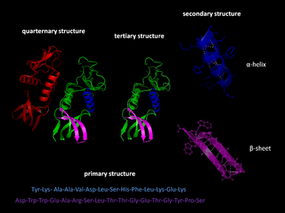
Types of protein structure

Slide 5
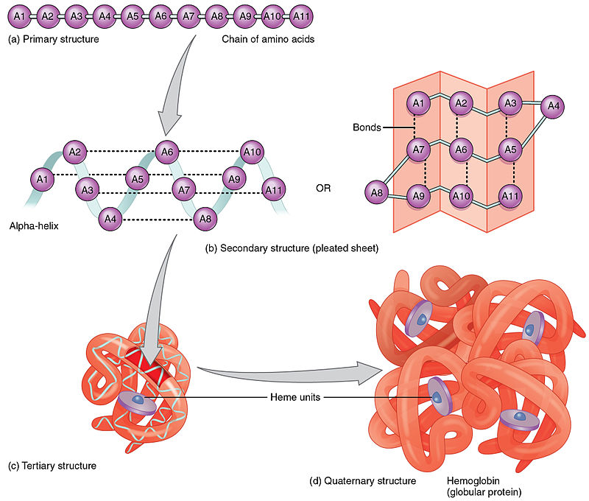

Slide 12
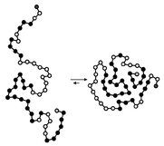
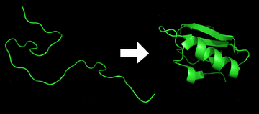
Protein folding

Slide 16
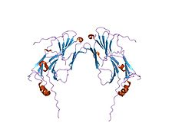
Molecular chaperons
Example of a small eukaryotic heat shock protein

Slide 20
Post-translational protein modifications
Frequency | Modification
58383 | Phosphorylation
6751 | Acetylation
5526 | N-linked glycosylation
2844 | Amidation
1619 | Hydroxylation
1523 | Methylation
1133 | O-linked glycosylation
878 | Ubiquitylation
826 | Pyrrolidone carboxylic acid
504 | Sulfation
Khoury GA, Baliban RC & Floudas CA (September 2011). "Proteome-wide post-translational modification statistics: frequency analysis and curation of the swiss-prot database". Scientific Reports. 1 (90): 90. Bibcode:2011NatSR...1E..90K. doi:10.1038/srep00090. PMC 3201773. PMID 22034591.

Slide 22
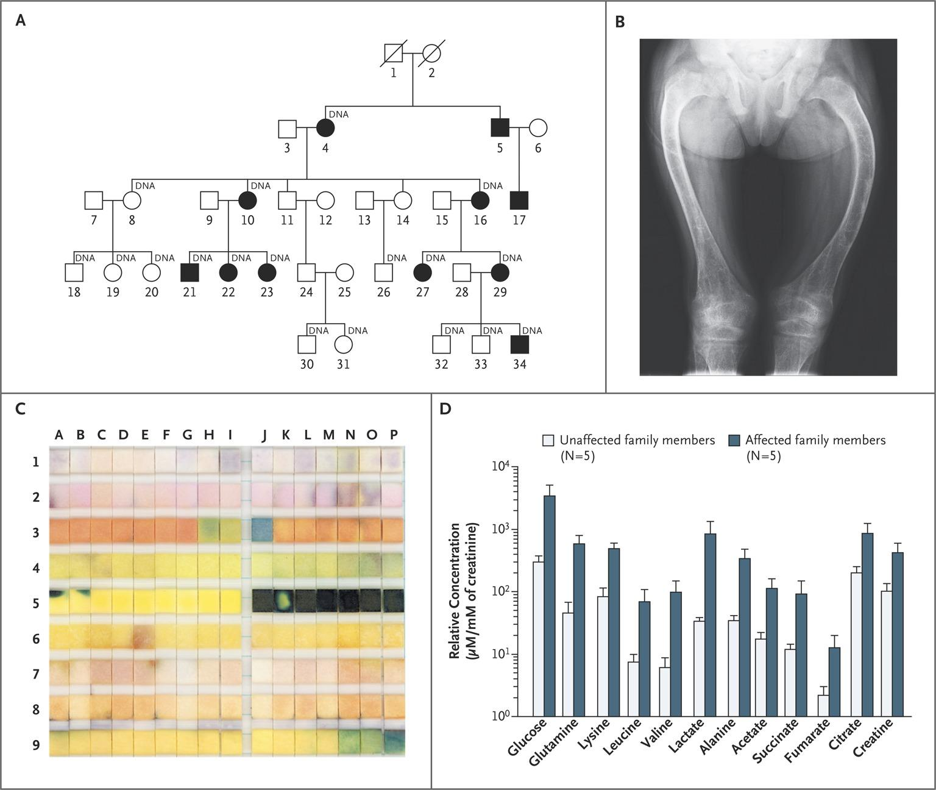
Clinical Characteristics of the Family Members.
Klootwijk ED et al. N Engl J Med 2014;370:129-138
From [Publication Title, Author(s), Title of Article, Volume No., Page No. Copyright © (notice year) Massachusetts Medical Society. Reprinted with permission from Massachusetts Medical Society.
Notes:
From New England Journal of Medicine, Klootwijk, ED., Reichold, M., Helip-Wooley, A., et al., Mistargeting of peroxisomal EHHADH and inherited renal Fanconi’s syndrome, 370(2), pp. 129–138. Copyright © 2014 Massachusetts Medical Society. Reprinted with permission from Massachusetts Medical Society.

Slide 23
A family with a disease in many generations
Rickets
Bone malformation
low calcium and phosphate levels in blood (despite adequate dietary intake)
Glucose in urine
Amino acids in urine
Brainstorm…
What do these symptoms have in common?

Slide 24
Nephron Function
Proximal Convoluted Tubule
Reabsorption
Active transport

Slide 25
In a peroxisomal protein (EHHADH)
Wild type (WT) EHHADH
Mitochondria (mitos)
WT (not in mitos)
Mutant EHHADH
Mitochondria (mitos)
Mutant (in mitos)
Klootwijk ED et al. N Engl J Med 2014;370:129-138
Notes:
From the appendix of the paper:
Top Panel (WT)
Left: WT EHHADAH protein (green); Middle: mitotracker (Red); right: Merge (no overlap)
Bottom Panel (Mutant)
Left: Mutant EHHADH protein (green) (note broader intracellular localization of mutant relative to WT); Middle: Mitotracker (red); right: Merge (see overlap)
Credit: From New England Journal of Medicine, Klootwijk, ED., Reichold, M., Helip-Wooley, A., et al., Mistargeting of peroxisomal EHHADH and inherited renal Fanconi’s syndrome, 370(2), pp. 129–138. Copyright © 2014 Massachusetts Medical Society. Reprinted with permission from Massachusetts Medical Society.

Slide 26
In a peroxisomal protein (EHHADH)
Wild type (WT) EHHADH
Mitochondria (mitos)
WT (not in mitos)
Mutant EHHADH
Mitochondria (mitos)
Mutant in mitos
& peroxisomes
Klootwijk ED et al. N Engl J Med 2014;370:129-138
Notes:
From the appendix of the paper:
Top Panel (WT)
Left: WT EHHADAH protein (green); Middle: mitotracker (Red); right: Merge (no overlap)
Bottom Panel (Mutant)
Left: Mutant EHHADH protein (green) (note broader intracellular localization of mutant relative to WT); Middle: Mitotracker (red); right: Merge (see overlap)
Credit: From New England Journal of Medicine, Klootwijk, ED., Reichold, M., Helip-Wooley, A., et al., Mistargeting of peroxisomal EHHADH and inherited renal Fanconi’s syndrome, 370(2), pp. 129–138. Copyright © 2014 Massachusetts Medical Society. Reprinted with permission from Massachusetts Medical Society.

